Slide 1
Theory and Simulation Investigation of Eutectic Phase Behavior on Pluto
Lovenia Libby, Gerrick Lindberg, Will Grundy
Northern Arizona University, Lowell Observatory

Slide 2
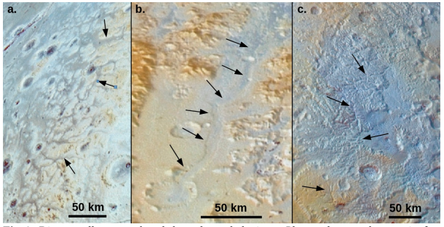
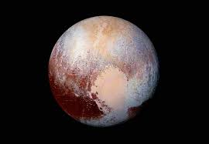
Liquid on Pluto
We hypothesize that a mixture of components with a uniquely low melting point can account for the appearance of liquid on Pluto.
New Horizons gave us images and insight into possible molecular components
Morphology suggests motion of fluid
35-50K temperatures
Experiments can be costly and time consuming

Slide 3
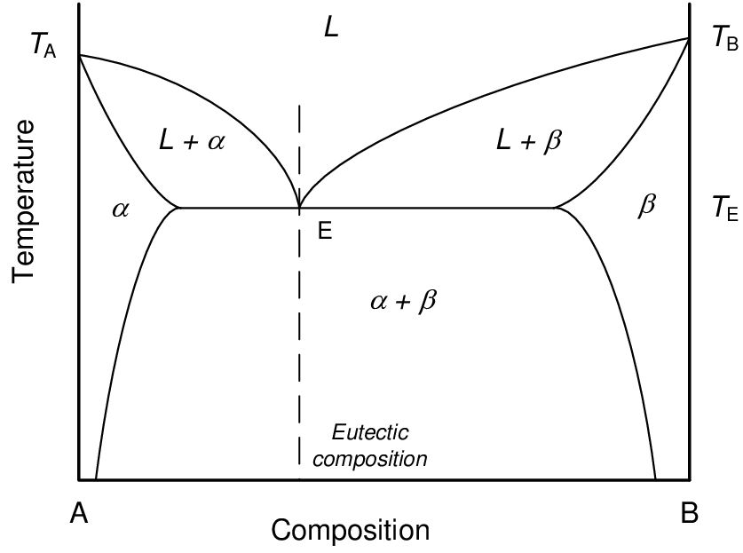
Eutectic Systems
Eutectic System: a homogenous mixture of substances that melts or solidifies at a single temperature that is lower than the melting point of any of the constituents
Eutectic Point: the chemical composition and temperature corresponding to the lowest melting point of a mixture
T is the modified melting point T_{f} is the melting point of the pure component R is the gas constant ∆H_{f} is the enthalpy of formation of the pure component X_{solvent} is the mole fraction of the component
Edler et. al. (2017) Guide on secondary thermometry

Slide 4
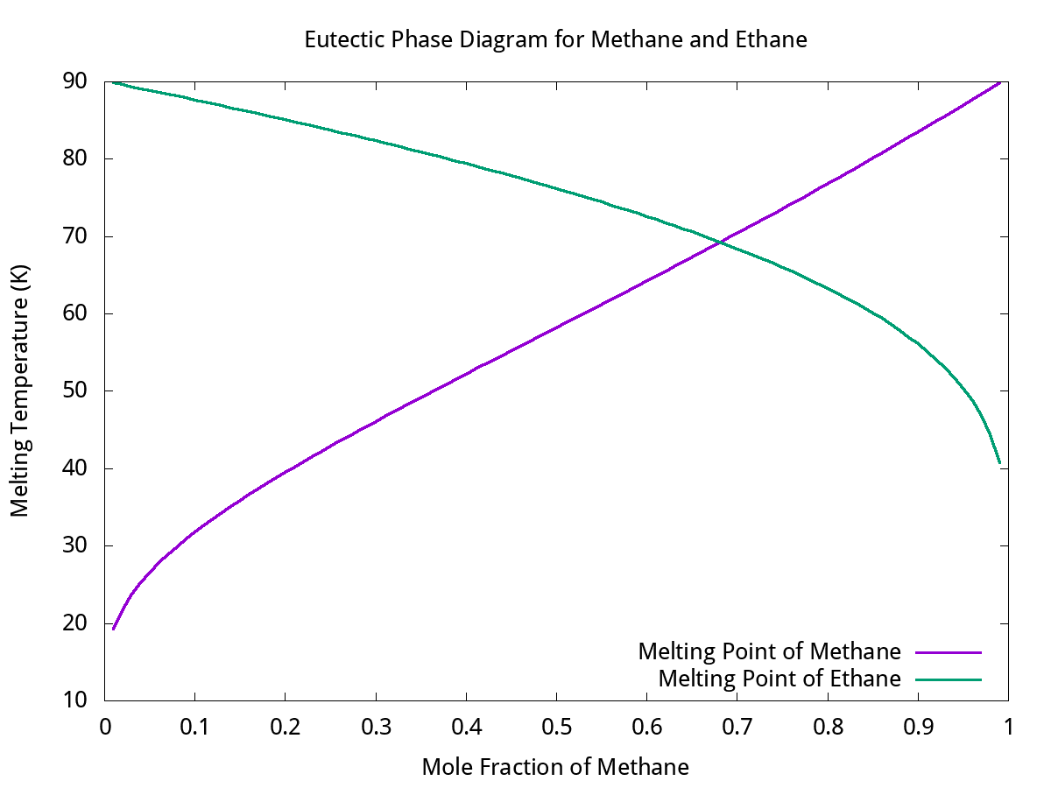
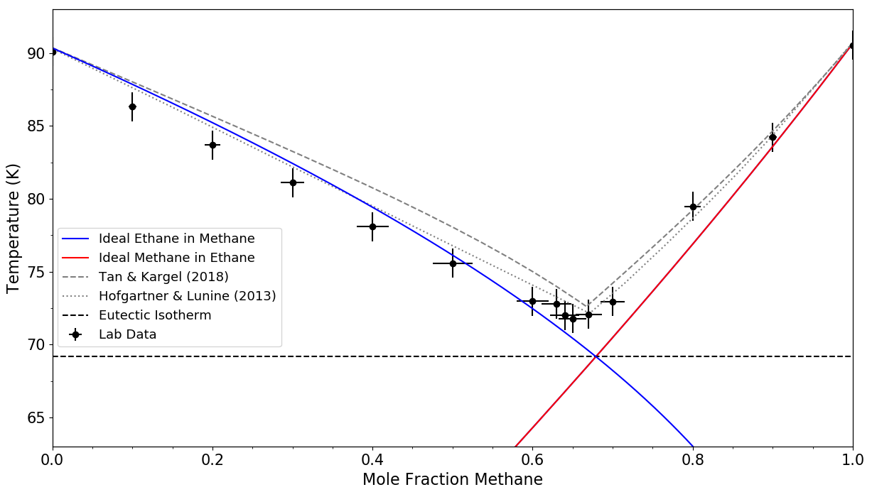
Theoretical Eutectic Point Calculations
All permutations’ eutectic point calculated where T_{f} are within a defined threshold
Modeling reflects experimental data
Only accounts for ideal behavior
Eutectic Temperature: 69.27 K
methane mole fraction: 0.68
ethane mole fraction: 0.32
Engle et al. Planetary Science Journal, In Press

Slide 5
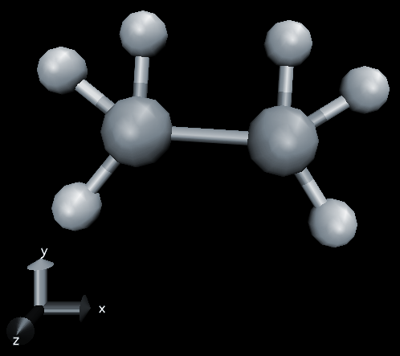
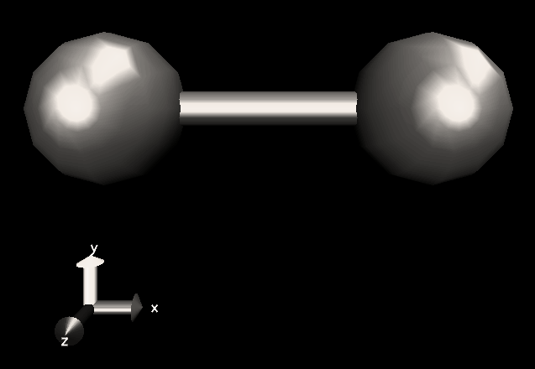
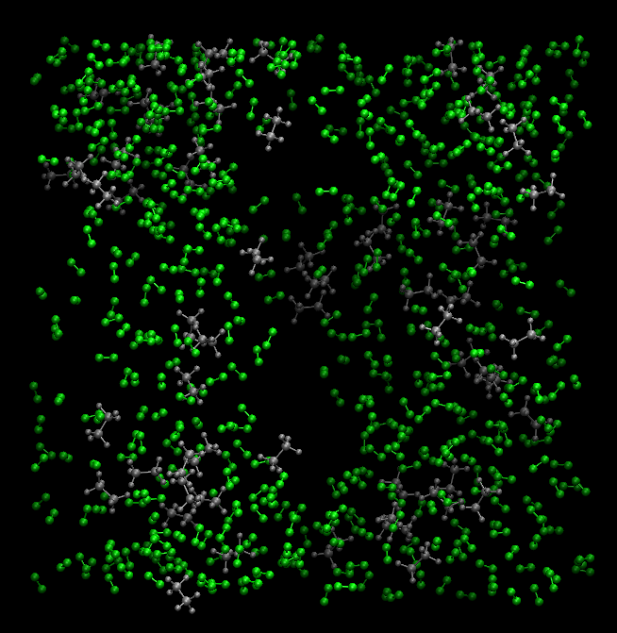
Molecular Dynamics
Predicting the trajectory of atoms over a fixed time in constricted space according to Newtonian equations
Examining small differences in how chemical systems behave
Assisted Model Building with Energy Refinement (AMBER)

Slide 6
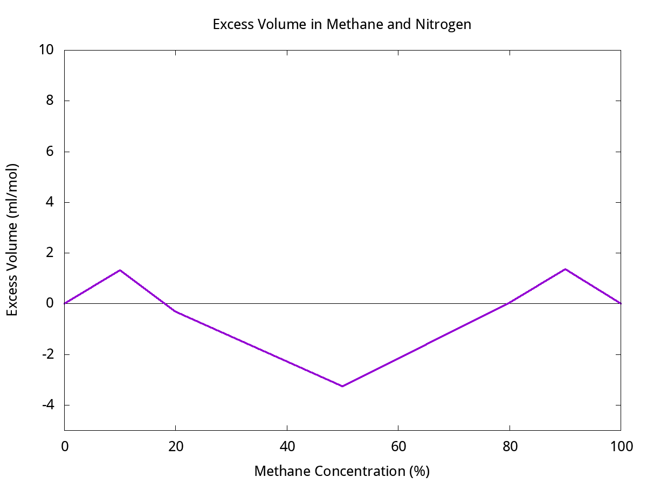
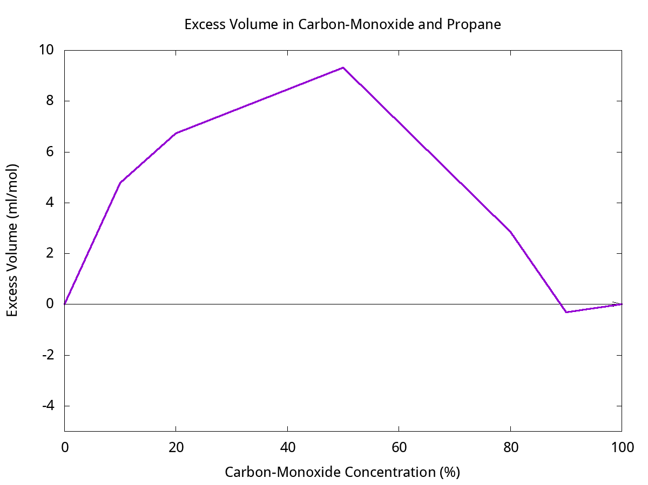
Deviation from Ideal Behavior
Real mixtures do not always behave according to theoretical models
Quantifying how atoms behave differently in mixture than they do alone
Excess and averages of density, volume, and potential energy
Inconsistency in radial distribution functions

Slide 7
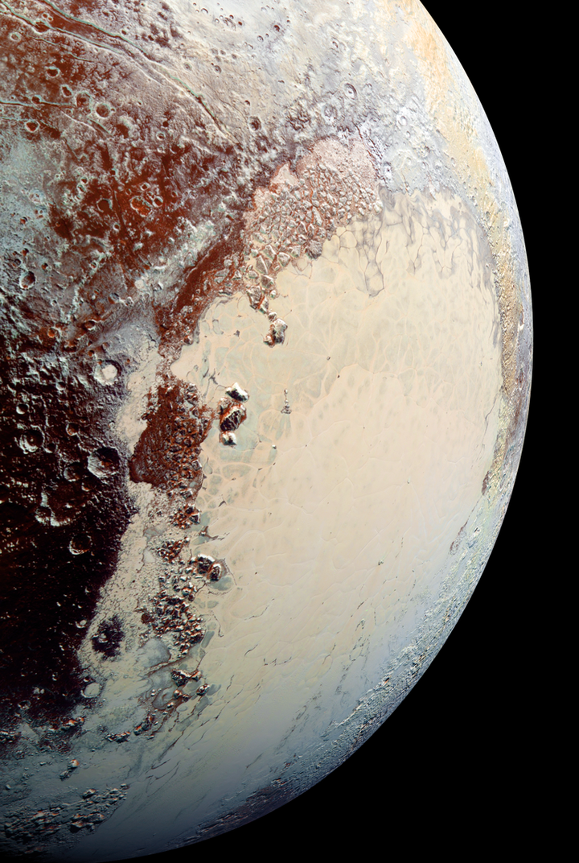
Future Research and Applications
Automation and optimization of:
Iteration through all proposed components
More analysis for trends in deviation from ideality
Physical experimentation with promising mixtures

Slide 8
Thank you
Acknowledgements
NAU, Lowell Observatory, and the NAU/Lowell Astrophysical Materials Lab
NAU’s Monsoon computing cluster, which is funded by Arizona’s Technology and Research Initiative Fund
NASA Space Grant Consortium

